Slide 1
UNIT I:
INTRODUCTION TO
GEOGRAPHIC
INFORMATION
SYSTEMS
TYBSC IT SEM VI
PROF. ARTI GAVAS
ANNA LEELA COLLEGE OF COMMERCE AND ECONOMICS,
SHOBHA JAYARAM SHETTY COLLGE FOR BMS, KURLA

Slide 2
ABOUT GIS: Definition
A Geographic Information System (GIS) is a computer system for capturing, storing, querying, analyzing, managing, and displaying geospatial data.

Slide 3
Gis applications
Directions on Map
Navigations
Crime analysis
Emergency planning
Land records management
Market analysis
Transportation planning
Remote sensing with GPS
Precision farming

Slide 4
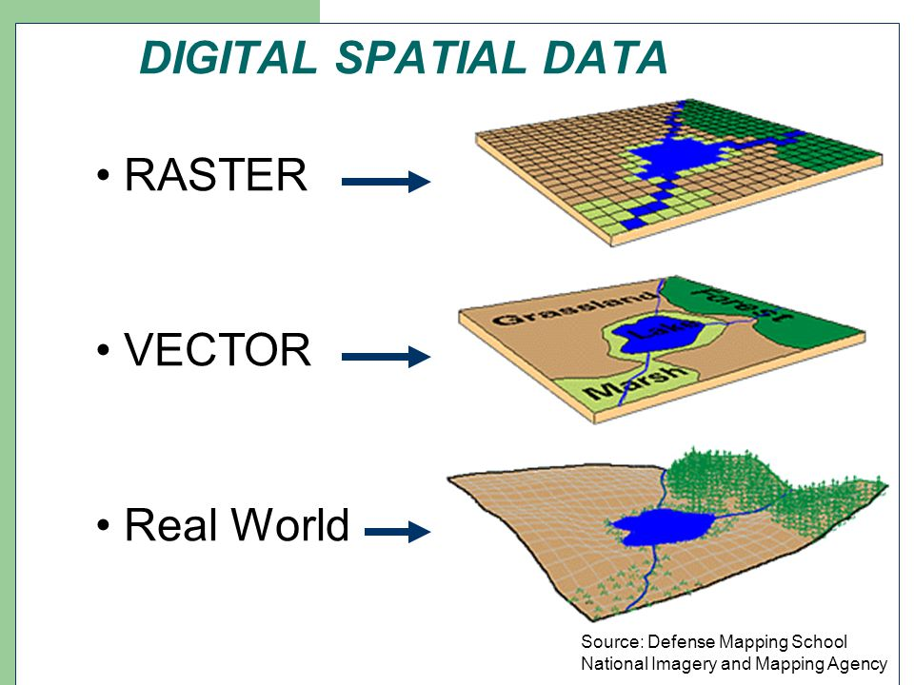
SPATIAL DATA
Spatial data, also known as geospatial data, is information about a physical object that can be represented by numerical values in a geographic coordinate system.

Slide 5
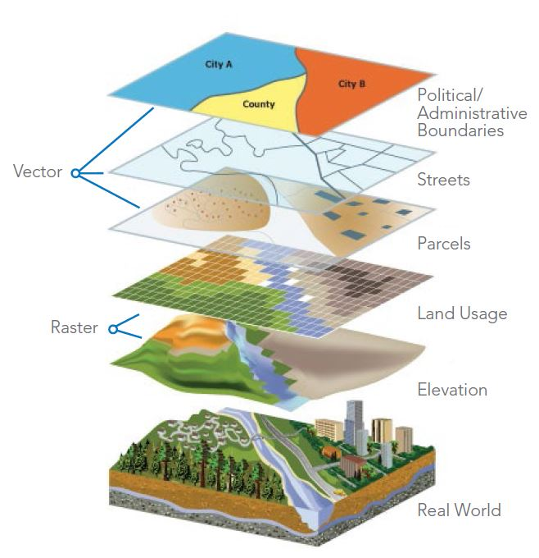
SPATIAL
DATA

Slide 6
GIS APPLICATIONS
Crime mapping
Historical geographic information systems
GIS and Hydrology
Remote sensing applications
Road networking
Wastewater and stormwater systems
Waste management

Slide 7
COMPONENTS OF GIS
A working GIS integrates five key components: hardware, software, data, people, and methods.
Hardware
Software
Data
People
Methods
Hardware is the computer on which a GIS operates. Today, GIS software runs on a wide range of hardware types, from centralized computer servers to desktop computers used in stand-alone or networked configurations
GIS software provides the functions and tools needed to store, analyze, and display geographic information. Key software components are: GUI, DBMS, TOOLS
Possibly the most important component of a GIS is the data. Geographic data and related tabular data can be collected in-house or purchased from a commercial data provider. A GIS will integrate spatial data with other data resources and can even use a DBMS, used by most organizations to organize and maintain their data, to manage spatial data.
GIS technology is of limited value without the people who manage the system and develop plans for applying it to real-world problems. GIS users range from technical specialists who design and maintain the system to those who use it to help them perform their everyday work.
A successful GIS operates according to a well-designed plan and business rules, which are the models and operating practices unique to each organization.

Slide 8
HISTORY OF GIS
There have been four distinct phases in the development of Geographic Information Systems.
Phase one, between the early 1960s and the mid 1970s saw a new discipline being dominated by a few key individuals who were to shape the direction of future research and development.
The second phase, from the mod 1970s to early 1980s saw the adoption of technologies by national agencies that led to a focus on the development of best practice.
Phase three, between 1982 until the late 1980s saw the development and exploitation of the commercial market place surrounding GIS whilst …
The final phase since the late 1980s has seen a focus on ways of improving the usability of technology by making facilities more user centric.

Slide 9
FUNDAMENTAL OBERVATIONS OF GIS
A Geographical Information System (GIS) is a system for
  capturing,
  storing,
  analyzing and
  managing data and associated attributes,
  which are spatially referenced to the Earth.
The geographical information system is also called as a geographic information system or geospatial information system.
It is an information system capable of integrating, storing, editing, analyzing, sharing, and displaying geographically referenced information.
In a more generic sense, GIS is a software tool that allows users to create interactive queries, analyze the spatial information, edit data, maps, and present the results of all these operations.
GIS technology is becoming essential tool to combine various maps and remote sensing information to generate various models, which are used in real time environment.
Geographical information system is the science utilizing the geographic concepts, applications and systems.

Slide 10
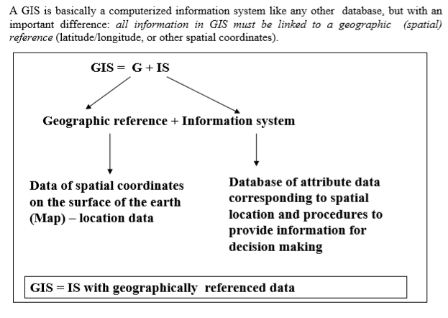
FUNDAMENTAL OBERVATIONS OF GIS

Slide 11
WHAT A GIS CAN DO ?
There are five basic questions which a complete GIS must answer. These are:
What exists at a particular location? Given a geographic reference (eg. lat, long) for a location, the GIS must describe the features of that location
Where can specific features be found? This is the converse of the first question. For example, where are the districts with rainfall greater than 500 mm and less than less than 750 mm?
Trends or What has changed over time? This involves answering both questions above. For example, at what locations are the crop yields showing declining trends?
What spatial patterns exist? if occurrence of a pest is associated with a hypothesized set of conditions of temperature, precipitation, humidity, where do those conditions exist?
Modeling or What if …? This is a higher level application of GIS and answers questions like what would be the nitrate distribution in groundwater over the area if fertilizer use is doubled?

Slide 12
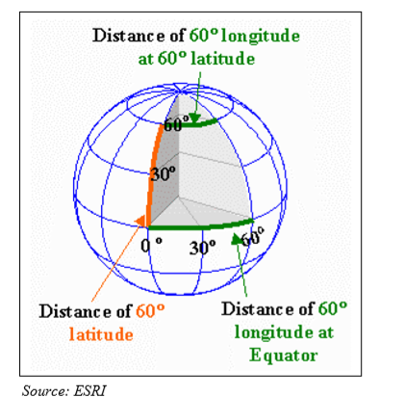
Geographic Coordinate System
The traditional way of representing locations on the surface of the earth is in the 3dimensional coordinate system is by its latitude and longitude:

Slide 13
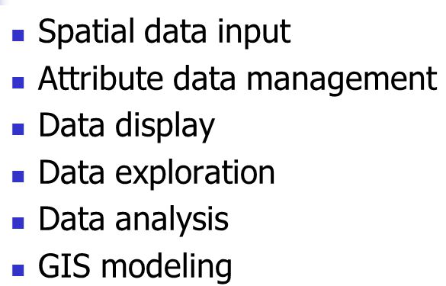
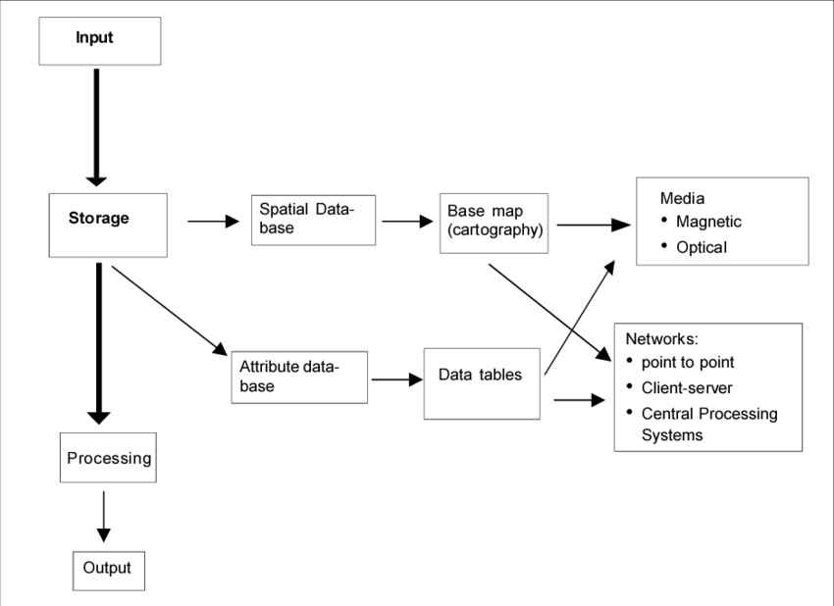
GIS OPERATIONS

Slide 14
Spatial Data Input
Date Capture and Preparation
Spatial Data Input: Geometric Transformation A newly digitized map has the same measurement unit (e.g. cm) as the source map used in digitizing or scanning.
This digitized map must be converted to real-world coordinates by using a set of control points and with known real-world coordinate and a process called geometric transformation.
Data entry
How?
  Buy or make
  Digitize
  Edit
  Raster or vector
  Coordinate System
  Projection
  Geometric transformation

Slide 15
Attribute Data Management
Data entry and verification
Database management
Accuracy
Standards
Attribute Data Management Activities include:
1.Data entry and verification 2.Database management To complete database construction for
a GIS project, attribute data must be entered, verified, and managed.
Two basic elements in the design of a relational database:
a)Key
b)type of data relationship: one-to-one, one-to- many, many-to-one

Slide 16
Data Display
Data Display
Data display through: Map:
Important for visualization and query.
Maps are also plotted to show results of GIS analysis.
Map Elements: Title, sub-title, body, legend, north arrow, scale, border. Map design is a creative process Tables Charts
Maps
Charts
Tables

Slide 17
Data Exploration
GIS Operation:
Data Exploration Data exploration is data-centered query and analysis.
The purpose of data exploration is to better understand the data and to help formulate research question and hypotheses.
Data query allows the user to:
– explore the general trends in the data
– Take a closer look at data subsets
– Focus on possible relationship between datasets Effective data exploration consists of interactive and dynamically linked visual tools, including maps, graphs, and tables.
Attribute data query
Spatial data query
Geographic visualization

Slide 18
Data Analysis
GIS Operation:
Data Analysis Data analysis in GIS is closely related to the data model (vector data model and raster data model)
Each data model has its own set of analytical functions Common Functions:
–For Vector data model: Buffering Map overlay Distance measurement Map manipulation
– For Raster Data Model: Map overlay, buffering etc. Raster data analysis can be conducted at the level of individual cells, (local level) or group of cells (neighbourhood or zonal), or cells within entire grid (global).
Vector data analysis
  Buffering, overlay, distance measures, map manipulation
Raster data analysis
  Local, neighborhood, zonal, global
Terrain mapping and analysis
Spatial interpolation
  Global and local
Regions-based analysis
Network analysis

Slide 19
GIS Modeling
GIS Operation:
A model is a simplified representation of a phenomenon or a system GIS modelling refers to the use of GIS in building analytical models with spatial data Example of GIS operation for modelling is Map Overlay
Map Overlay:
– Combines spatial and attribute data of different spatial features into a composite map.
– Since each map feature on the composite map represents a selected set of data characteristics by location, the composite map can be further process to extract new information for modeling purpose.
Types of GIS models: – a) Binary, b) Index, c) Regression, d) Process
Binary models (simple criteria fit)
Index models (ranked index)
Regression models (dependent vs independent variables)
Process models (real world)

Slide 20
    GISystems, GIScience and GIS applications
GIS is a computerized system that facilitates the phases of data entry, data management, data analysis and data presenta- tion specifically for dealing with georeferenced data.
In the ‘wider’ sense, a functioning GIS requires both hardware and software, and also people such as the database creators or administrators, analysts who work with the software, and the users of the end product.
They all are making GISystems.
Hardware
Software
people
  the database creators or administrators,
  analysts who work with the software,
  and the users of the end product.

Slide 21
    GISystems, GIScience and GIS applications
The discipline that deals with all aspects of the handling of spatial data and geoinformation is called geographic information science (often abbreviated to geo- information science or just GIScience).
  Geo-Information Science is the scientific field that attempts to integrate different disciplines studying the methods and techniques of handling spatial information.

Slide 22
    Spatial data and Geo-information
    A subtle difference exists between the terms data and information.
By data, we mean representations that can be operated upon by a computer.
More specifically, by spatial data we mean data that contains positional values, such as (x, y) co-ordinates.
information, we mean data that has been interpreted by a human being.
Humans work with and act upon information, not data.
Human perception and mental processing leads to information, and hopefully understanding and knowledge.
Geoinformation is a specific type of information resulting from the interpretation of spatial data.
Information is intended to reduce uncertainty in decision-making, any errors and uncertainties in spatial information products may have practical, financial and even legal implications for the user.

Slide 23
    Spatial data and geoinformation
    A subtle difference exists between the terms data and information.
Traditionally, most spatial data were collected and held by individual, specialized organizations.
In recent years, increasing availability and decreasing cost of data capture equipment has resulted in many users collecting their own data.
However, the collection and maintenance of ‘base’ data remain the responsibility of the various governmental agencies, such as National Mapping Agencies (NMAs), which are responsible for collecting topographic data for the entire country following pre-set standards.
Other agencies such as geological survey companies, energy supply companies, local government departments, and many others, all collect and maintain spatial data for their own particular purposes.
If data is to be shared among different users, these users need to know not only what data exists, where and in what format it is held, but also whether the data meets their particular quality requirements. This ‘data about data’ is known as metadata.

Slide 24
    Spatial data and geoinformation
    A subtle difference exists between the terms data and information.
Since the real power of GIS lies in their ability to combine and analyse georeferenced data from a range of sources, we must pay attention to the issues of data quality and error,
As data from different sources are also likely to contain different kinds of error.
This may include mistakes or variation in the measurement of position and/or elevation, in the quantitative measurement of attributes or metadata in the labelling or classification of features.
Some degree of error is present in every spatial data set.
It is important, however, to distinguish between gross errors (blunders or mistakes), which must be detected and removed before the data is used, variations in the data caused by unavoidable measurement and classification errors.

Slide 25
    Spatial data and geoinformation
Key components of spatial data quality include
positional accuracy (both horizon- tal and vertical),
temporal accuracy (that the data is up to date),
attribute accuracy(e.g. in labelling of features or of classifications),
lineage (history of the data in- Data quality parameters cluding sources),
completeness (if the data set represents all related features of reality), and
logical consistency (that the data is logically structured).

Slide 26
    The real world and representations of it
One of the main uses of GIS is as a tool to help us make decisions.
  Specifically, we often want to know the best location for a new facility,
  the most likely sites for mosquito habitat,
  or perhaps identify areas with a high risk of flooding so that we can formulate the best policy for prevention.
In using GIS to help make these decisions, we need to represent some part of the real world as it is, as it was, or perhaps as we think it will be.
We need to restrict ourselves to ‘some part’ of the real world simply because it cannot be represented completely.
The El Nin˜o system has as its purpose the administration of SST and WS in various places in the equatorial Pacific Ocean, and to generate georeferenced, monthly overviews from these.
If this is its complete purpose, the system does not need to store data about the ships that moored the buoys, the manufacture date of the buoys et cetera. All this data is irrelevant for the purpose of the system.

Slide 27
    Models and modeling
‘Modelling’ is a representation of some part of the real world can be considered a model because the representation will have certain characteristics in common with the real world. Specifically, those which we have identified in our model design.
This then allows us to study and operate on the model itself instead of the real world in order to test what happens under various conditions, and help us answer ‘what if’ questions. We can change the data or alter the parameters of the model, and investigate the effects of the changes.
A ‘real world model’ is a representation of a number of phenomena that we can observe in reality, usually to enable some type of
study,
administration,
computation and/or
simulation.
The phrase ‘data modelling’ is the common name for the design effort of structuring a database.
This process involves the identification of the kinds of data that the database will store, as well as the relationships between these kinds of data.

Slide 28
    Static Models and Dynamic Models
Most maps and databases can be considered static models.
At any point in time, they represent a single state of affairs.
Usually, developments or changes in the real world are not easily recognized in these models.
Dynamic models or process models address precisely this issue.
They emphasize changes that have taken place, are taking place or may take place sometime in the future.
Dynamic models are inherently more complicated than static models, and usually require much more computation.
Simulation models are an important class of dynamic models that allow the simulation of real world processes.

Slide 29
    Maps
Maps are perhaps the best known (conventional) models of the real world.
Maps have been used for thousands of years to represent information about the real world, and continue to be extremely useful for many applications in various domains.
Their conception and design has developed into a science with a high degree of sophistication.
A disadvantage of the traditional paper map is that it is generally restricted to two-dimensional static representations, and that it is always displayed in a fixed scale.
The map scale determines the Map spatial resolution of the graphic feature representation.
The smaller the scale, the less detail a map can show.
The accuracy of the base data, on the other hand, puts limits to the scale in which a map can be sensibly drawn.
Hence, the selection of a proper map scale is one of the first and most important steps in map design.

Slide 30
    Maps
A map is always a graphic representation at a certain level of detail, which is determined by the scale.
Map sheets have physical boundaries, and features spanning two map sheets have to be cut into pieces.
Cartography, as the science and art of map making, functions as an interpreter, translating real world phenomena (primary data) into correct, clear and understandable representations for our use.
Maps also become a data source for other applications, including the development of other maps.

Slide 31
    Maps
With the advent of computer systems, analogue cartography developed into digital cartography, and computers play an integral part in modern cartography.
Alongside this trend, the role of the map has also changed accordingly, and the dominance of paper maps is eroding in today’s increasingly ‘digital’ world.
The traditional role of paper maps as a data storage medium is being taken over by (spatial) databases, which offer a number of advantages over ‘static’ maps, as discussed in the sections that follow. Notwithstanding these developments, paper maps remain as important tools for the display of spatial information for many applications.

Slide 32
    Databases
A database is a repository for storing large amounts of data. It comes with a number of useful functions:
A database can be used by multiple users at the same time—i.e. it allows concurrent use,
A database offers a number of techniques for storing data and allows the use of the most efficient one—i.e. it supports storage optimization,
A database allows the imposition of rules on the stored data; rules that will be automatically checked after each update to the data—i.e. it supports data integrity,
A database offers an easy to use data manipulation language, which allows the execution of all sorts of data extraction and data updates—i.e. it has a query facility,
A database will try to execute each query in the data manipulation lan- guage in the most efficient way—i.e. it offers query optimization.

Slide 33
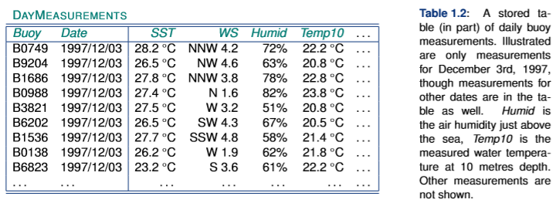
    Databases
Table was obtained from table D AYMEASUREMENTS through the use of a query language.
A query was defined that computes the monthly average SST from the daily measurements, for each buoy.
A discussion of the particular query language that was used is outside the scope of this book, but we

Slide 34
    Spatial databases and spatial analysis
In more recent years, spatial databases (also known as geodatabases) have emerged.
Besides traditional administrative data, they can store representations of real world geographic phenomena for use in a GIS.
These databases are special because they use additional techniques different from tables to store these spatial representations.
The phenomena for which we want to store representations in a spatial database may have
  point,
  line,
  area or image characteristics.
Different storage techniques exist for each of these kinds of spatial data.
These geographic phenomena have various relationships with each other and possess spatial (geometric), thematic and temporal attributes (they exist in space and time).
For data management purposes, phenomena are classified into thematic data layers.
The purpose of the database is usually described by a description such as cadastral, topographic, land use, or soil database.

Slide 35
    Spatial analysis
Spatial analysis is the generic term for all manipulations of spatial data carried out to improve one’s understanding of the geographic phenomena that the data represents.
It involves questions about how the data in various layers might relate to each other, and how it varies over space.
For example, in the El Nin˜o case, we may want to identify the the steepest gradient in water temperature.
The aim of spatial analysis is usually to gain a better understanding of geographic phenomena through discovering patterns that were previously unknown to us,
or to build arguments on which to base important decisions.
It should be noted that some GIS functions for spatial analysis are simple and easy-to-use, others are much more sophisticated, and demand higher levels of analytical and operating skills.
Successful spatial analysis requires appropriate software, hardware, and perhaps most importantly, a competent user.

Slide 36
THANK YOU!
TYBSC IT SEM VI
PROF. ARTI GAVAS
ANNA LEELA COLLEGE OF COMMERCE AND ECONOMICS,
SHOBHA JAYARAM SHETTY COLLGE FOR BMS, KURLA

